Slide 1
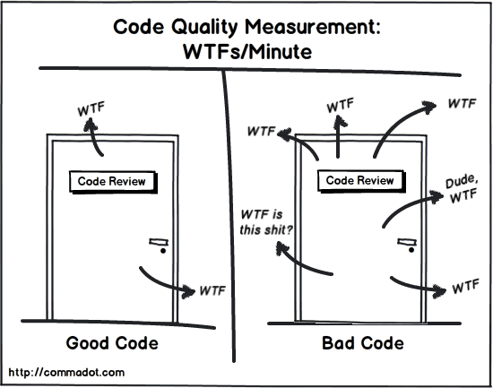
Code quality
Ivan Cipriani
Notes:
Very small or nothing come from personal opinion all info are gathering by Plural sight but of course agree on all of them
I tried to apply all of them in my working hours but probably not always I reach my goals

Slide 2
Agenda
Clean Code Principles
Git - ACID commit (not in this presentation)
Testing - ISTQB (not in this presentation)
Code Analysis (short intro)
Code Review

Slide 3
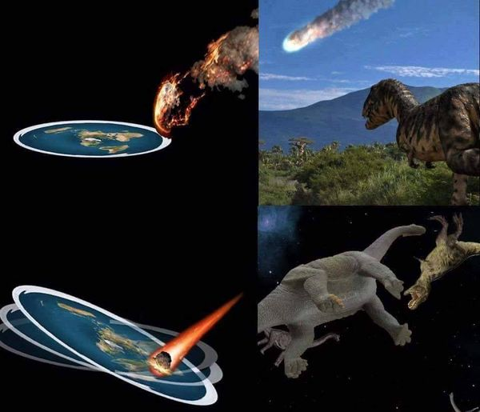
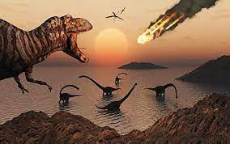
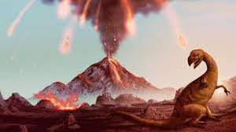
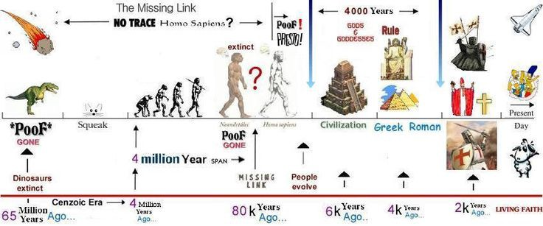
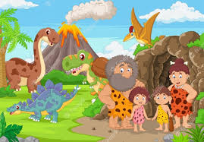

Nugget of wisdom (Uncle Bob)
Decrease temperature
When? 65 million years ago
Why?
3
Notes:
This is the most if you think that the earth is flat this is another option and the probabilty tha flat earth is between us in this room is not so small
Instead if you think about the whole time of the earth like 24 hours we lived only one second.
The age of the earth is around 4,5 miliard of years un third of the univers

Slide 4
Right tool for the job High signal to noise ratio Self-documenting
Clean Code Principles
1

Slide 5
Right tool for the job
1.1

Slide 6
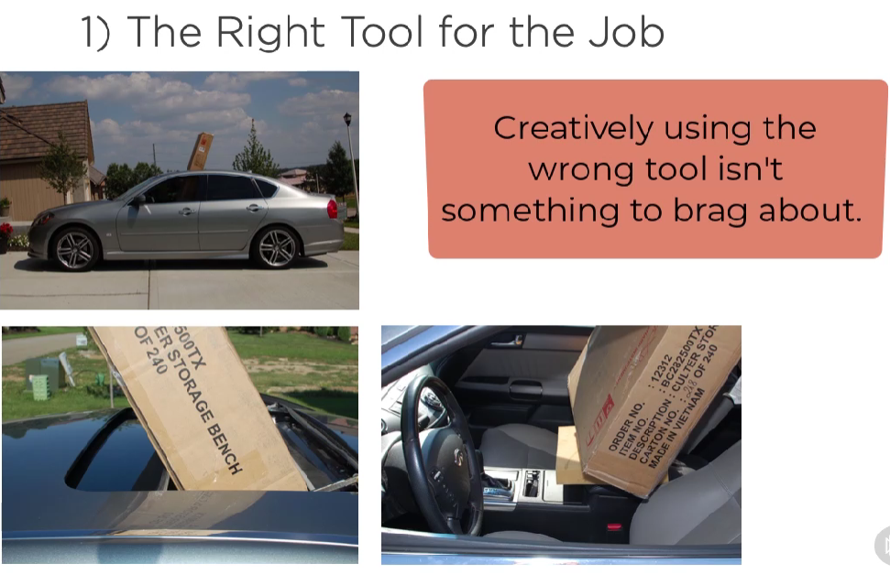
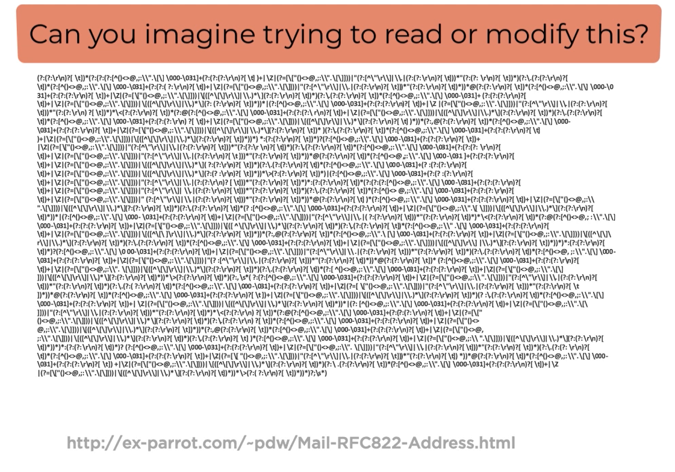
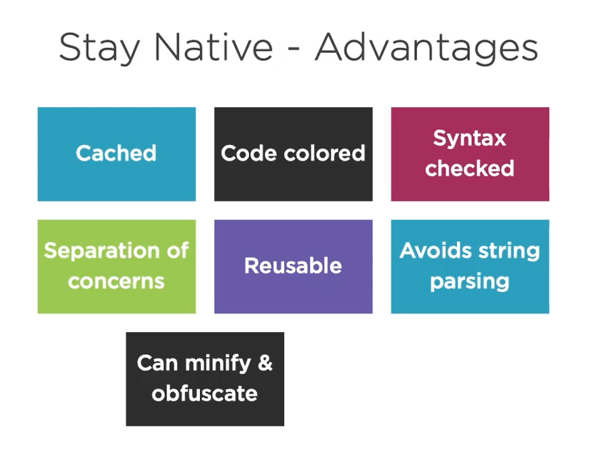
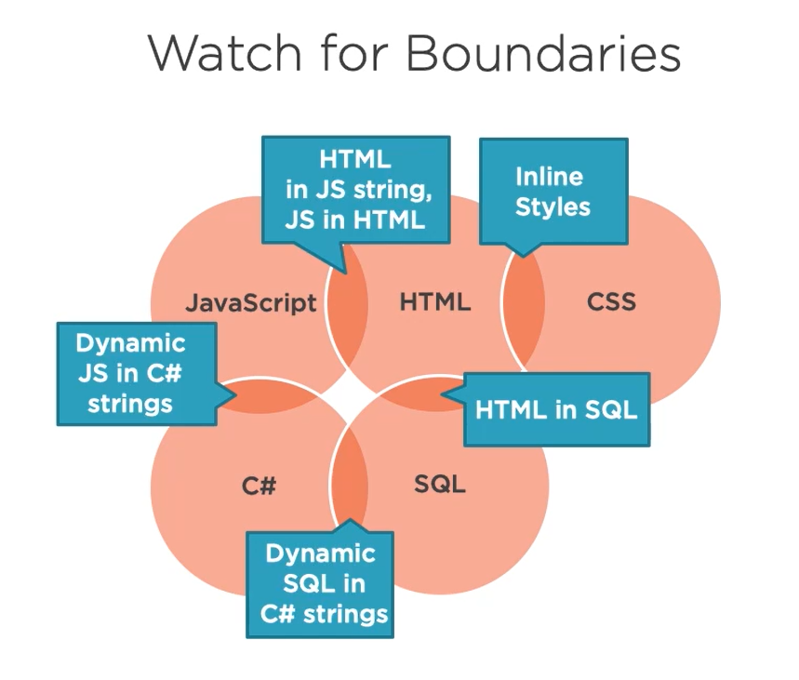

Slide 7
Naming Convection Booleans Complex conditionals Function Exceptions Classes
High signal to noise ratio
1.2

Slide 8
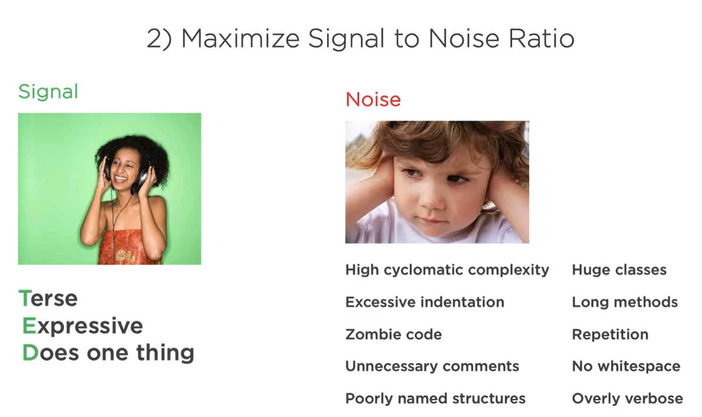
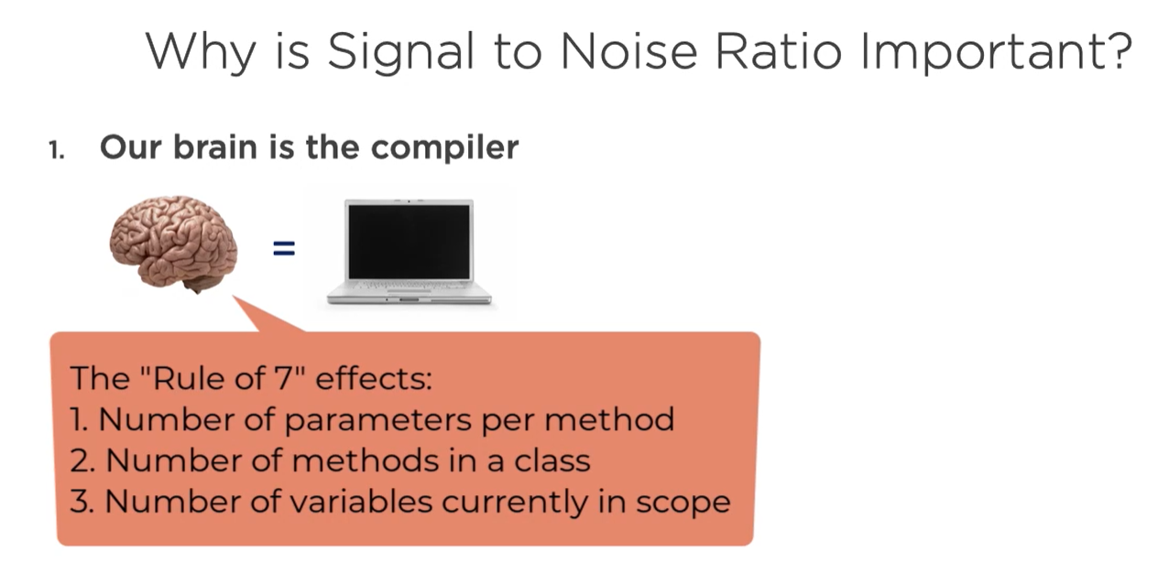
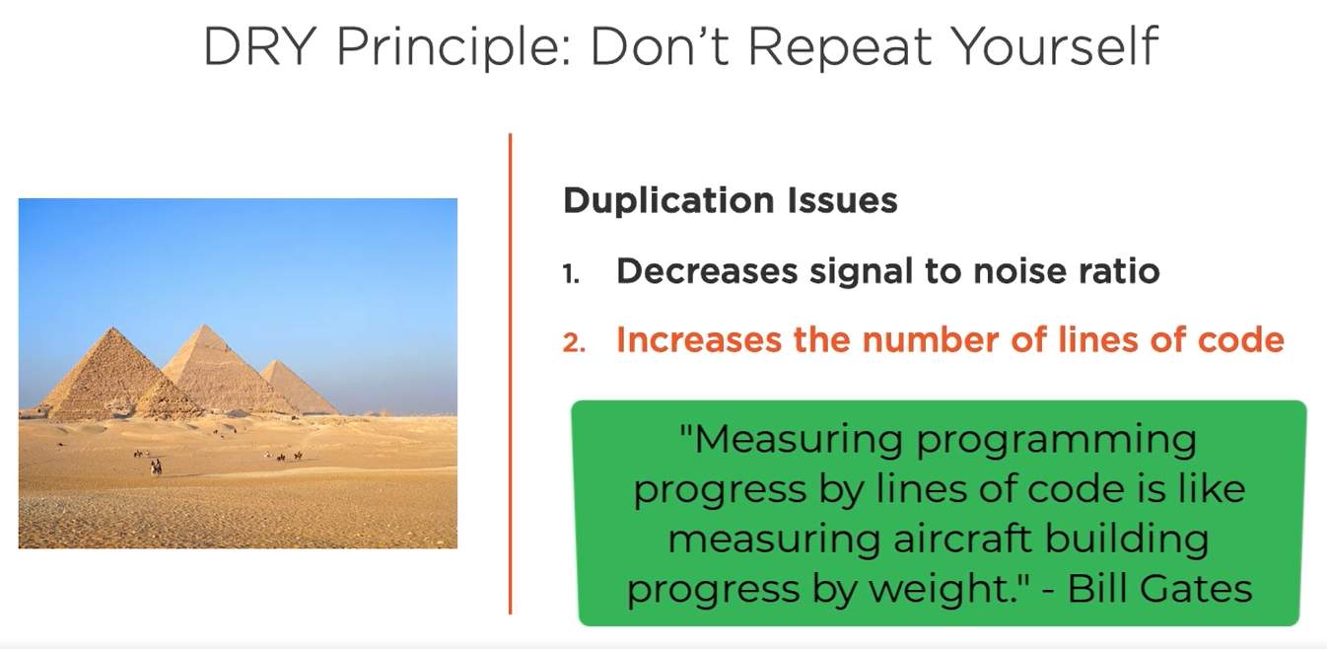
Notes:
The “Terse, Expressive, Does one thing” is most commonly known as TED Rule or TED Principle. Thus, Its main concept is naming of code should be easy to understand by everyone (software engineers). So, when writing a code. We should consider that our audience isn’t just a computer but also a human.
1. Seven Plus or Minus Two
According to cognitive psychologist George A. Miller of Harvard University’s Department of Psychology, seven is a magic number. And the power of this ‘magic number’ is well worth considering when it comes to your business strategy.
What makes no.7 so special?
The number seven isn’t just associated with good luck in a card game – it’s also pivotal when it comes to our capacity as humans to process information – and the foundational paper, produced by Professor Miller, is one of psychology’s most cited papers in history. Also called ‘Miller’s Law’ it explains that people can only hold seven plus or minus two items, in their short-term memory at any one time and that the magic number of seven itself is the best for memory recall.

Slide 9
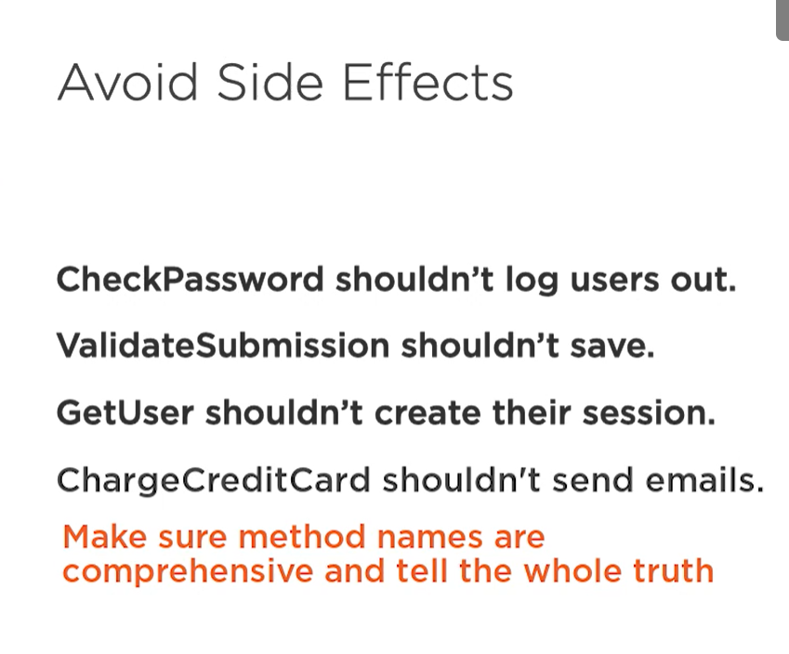
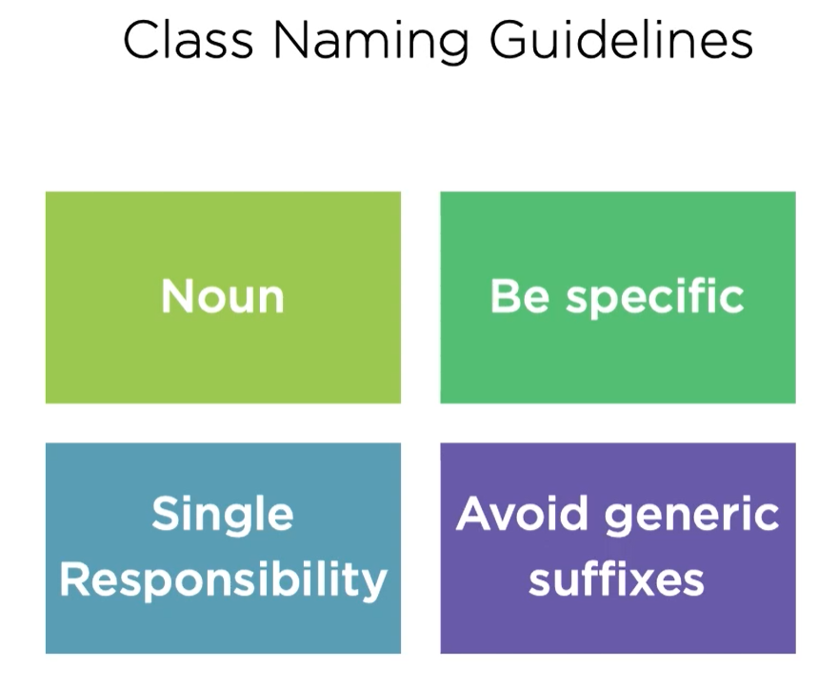
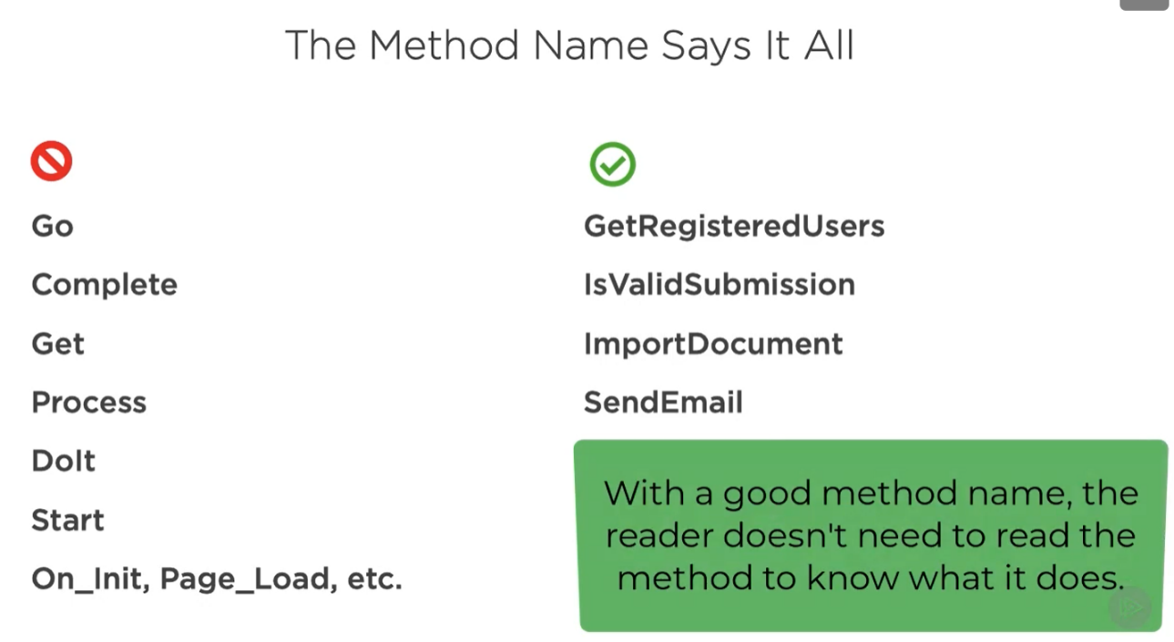
Naming Convection
Avoid abbreviations
Naming Warning Signs
Follow Solid Principle

Slide 10
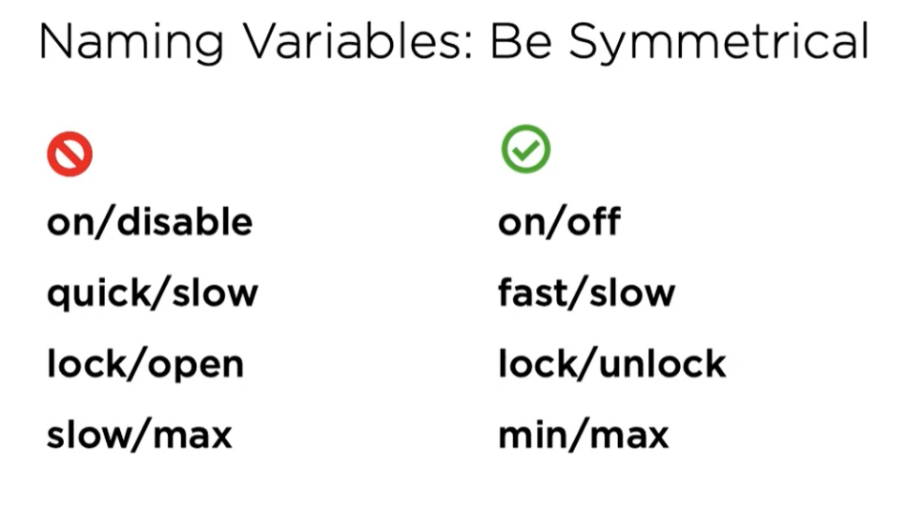
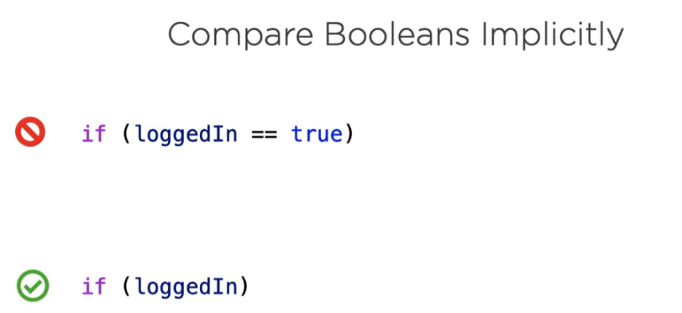
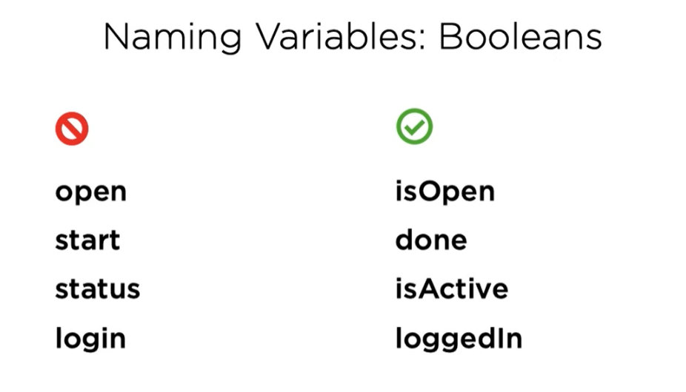
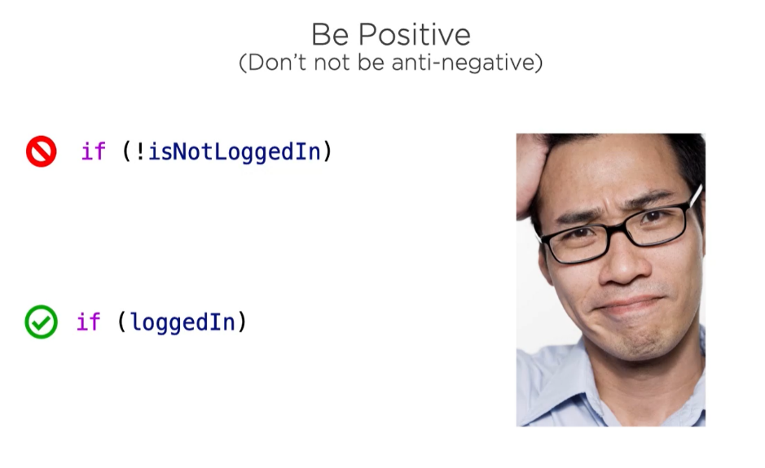
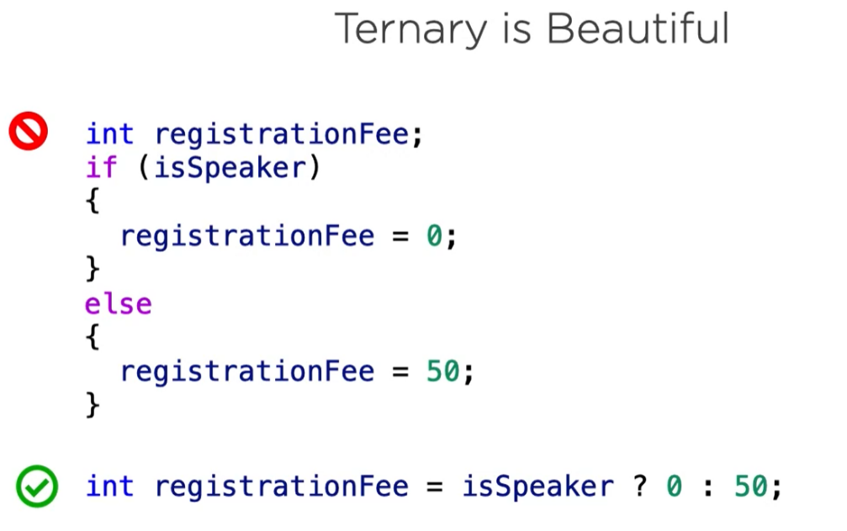
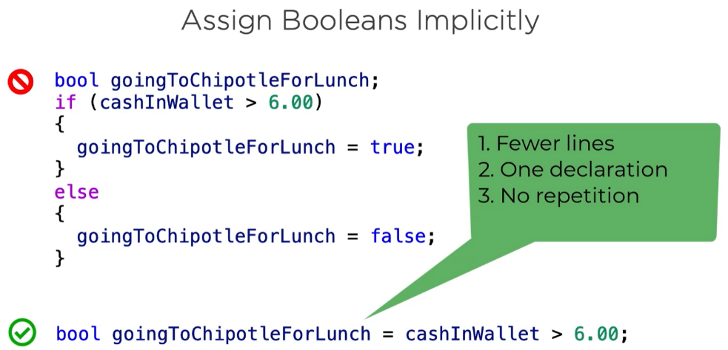
Booleans

Slide 11
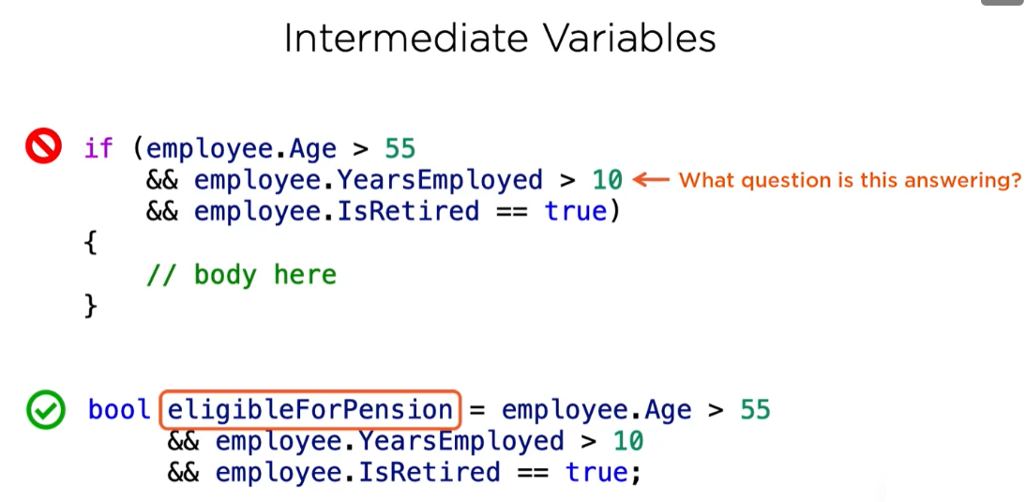
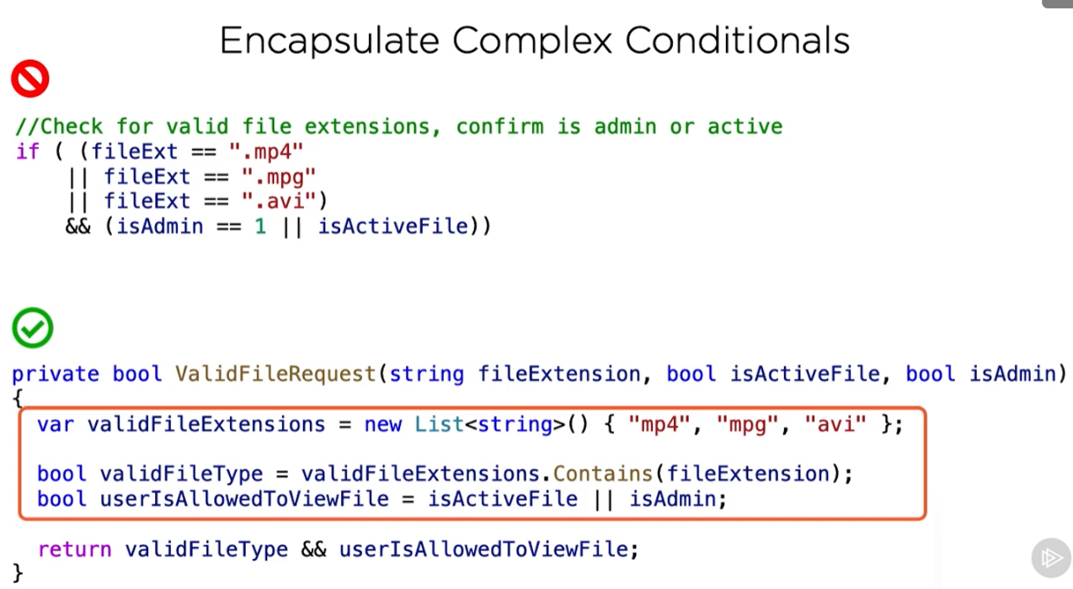
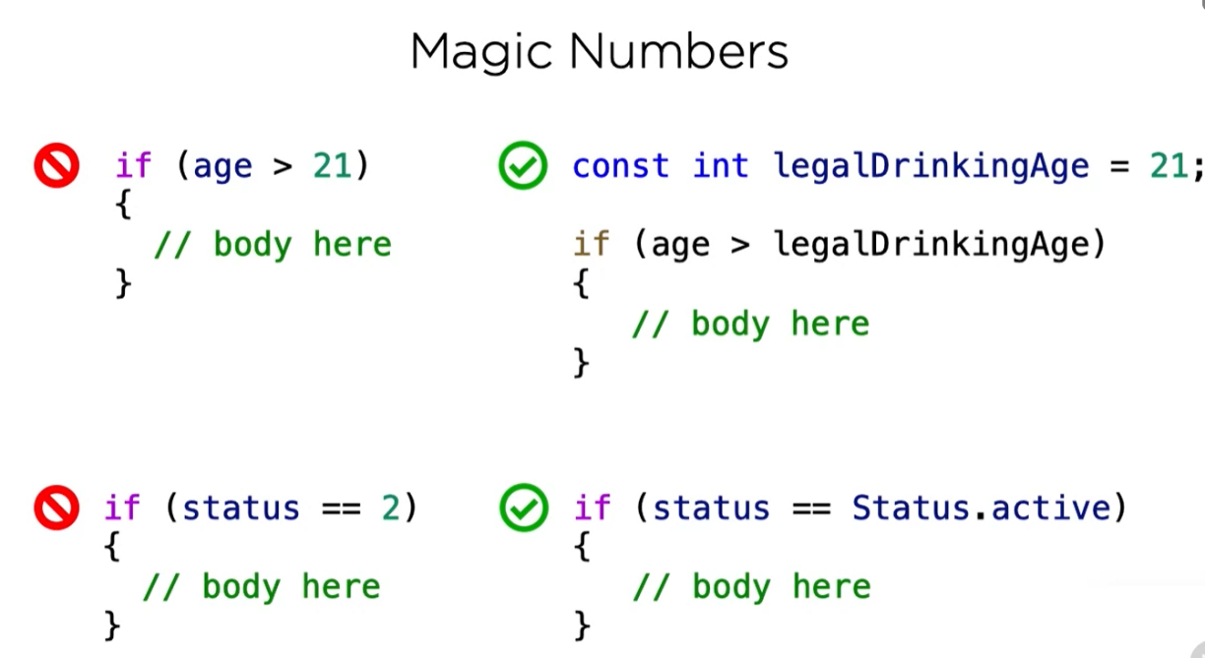
Complex conditionals

Slide 12
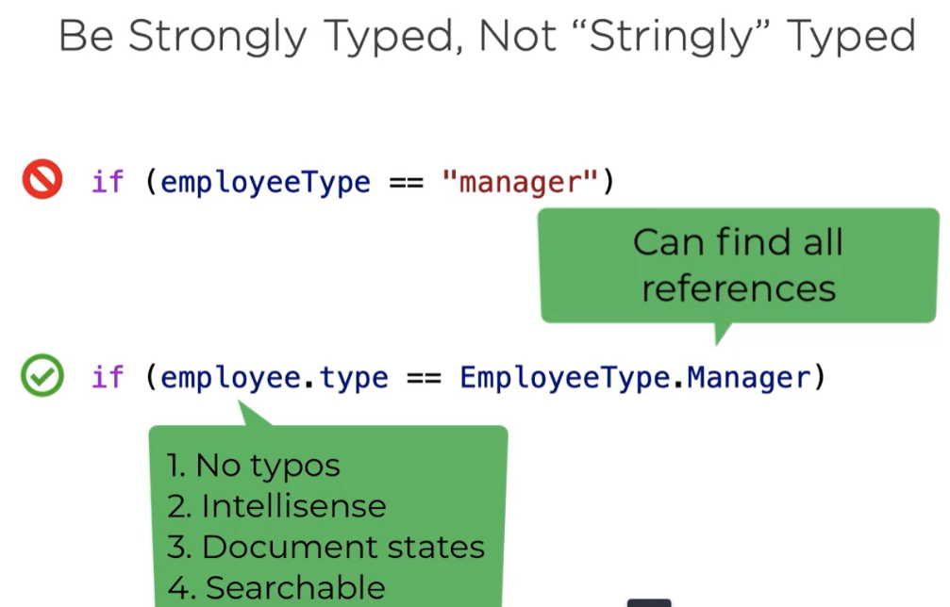
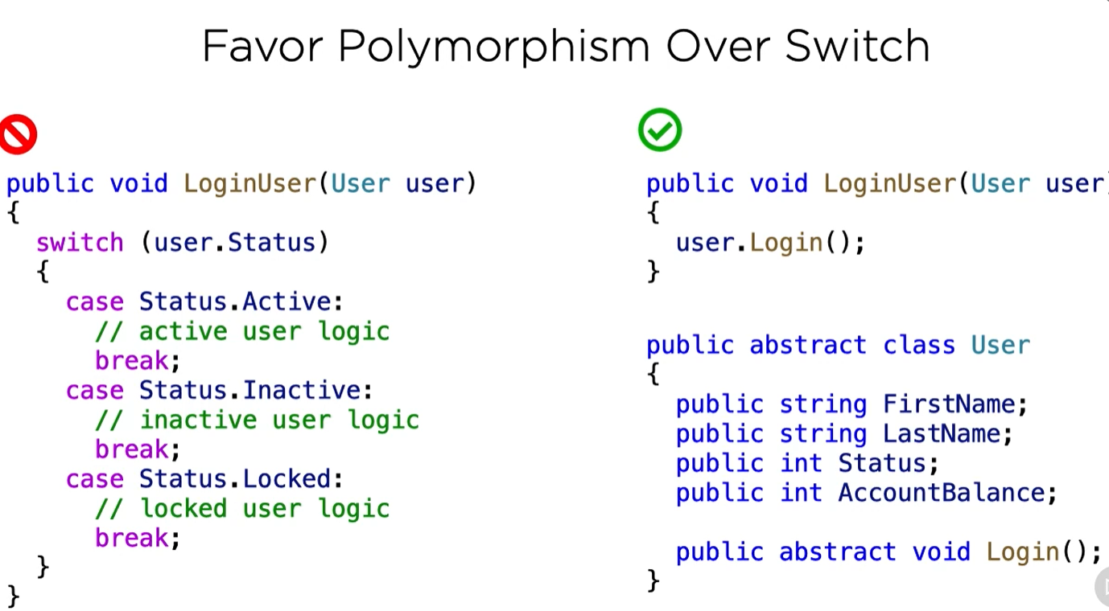
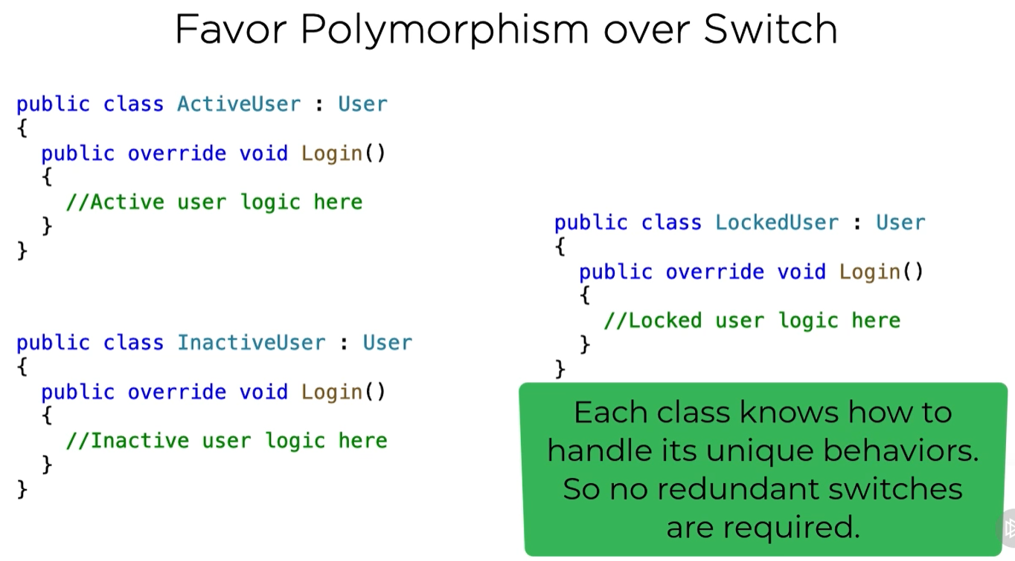
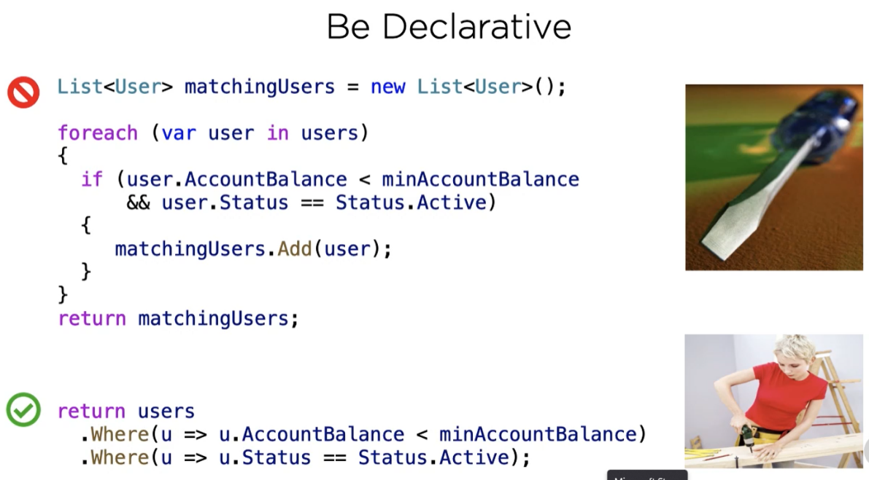

Slide 13
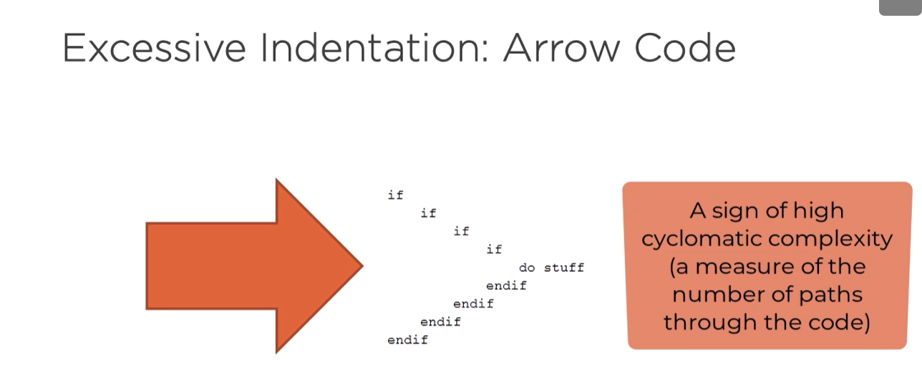
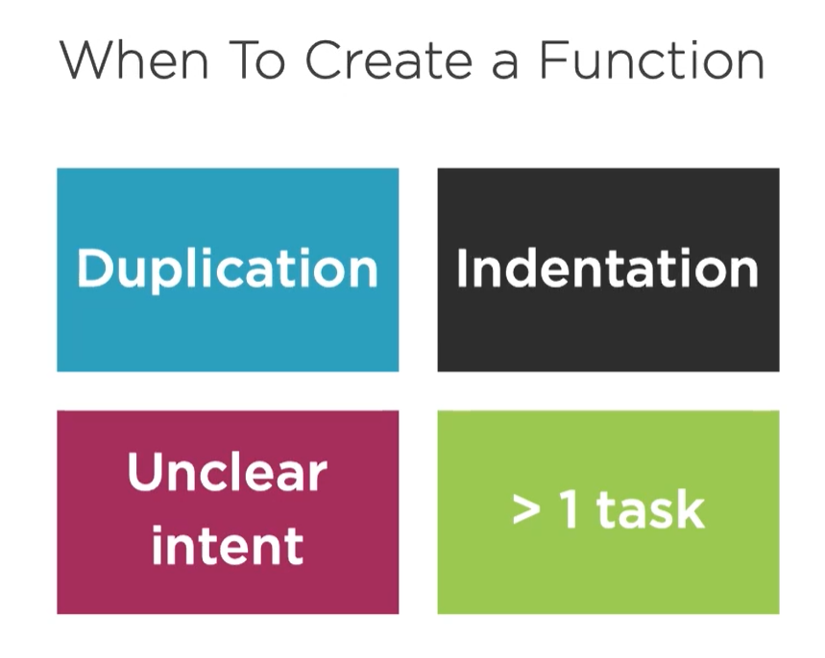
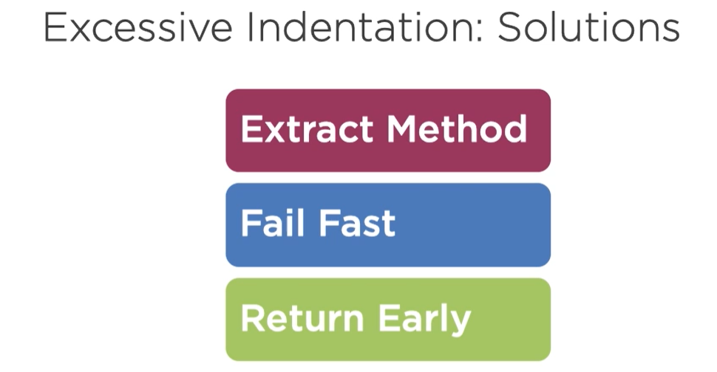
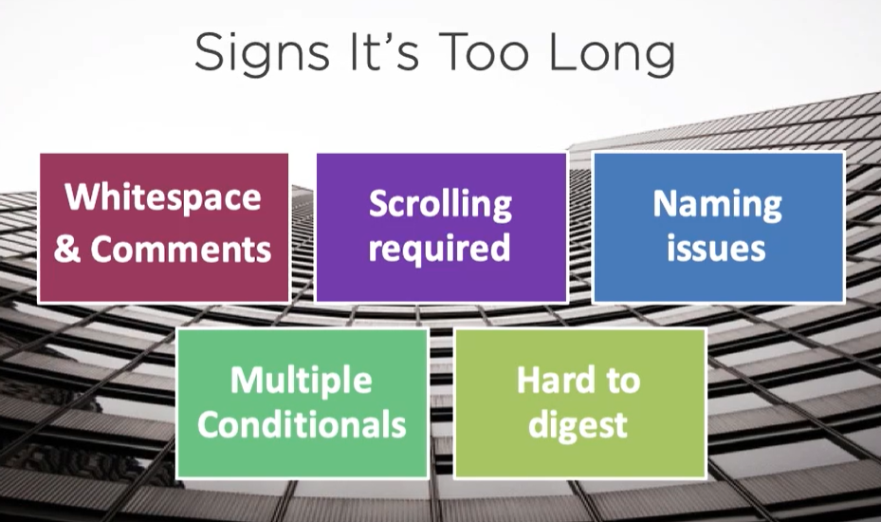
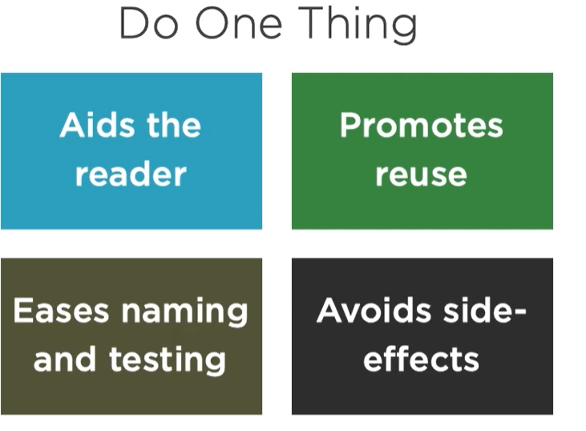
Functions

Slide 14
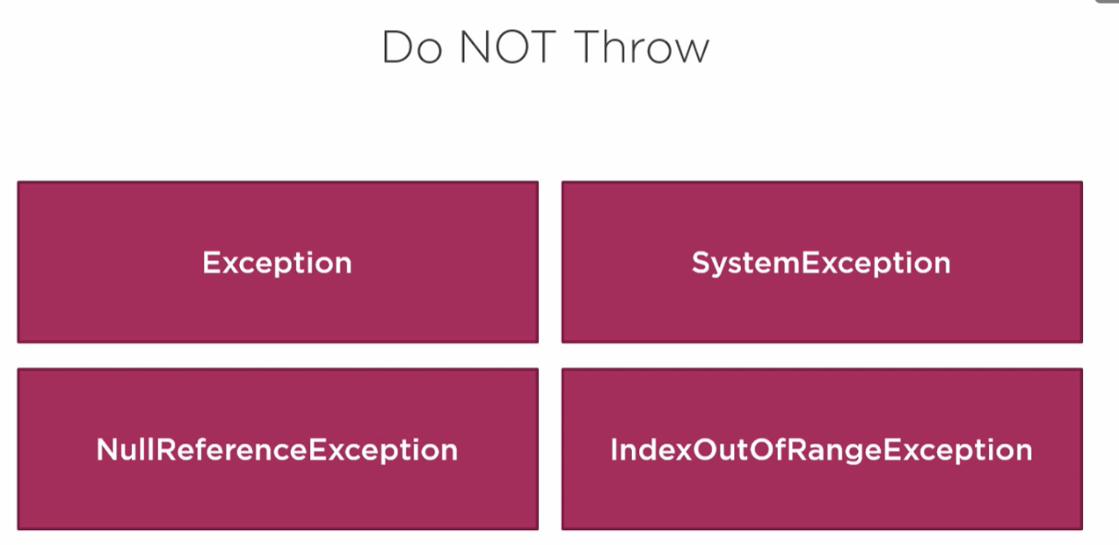
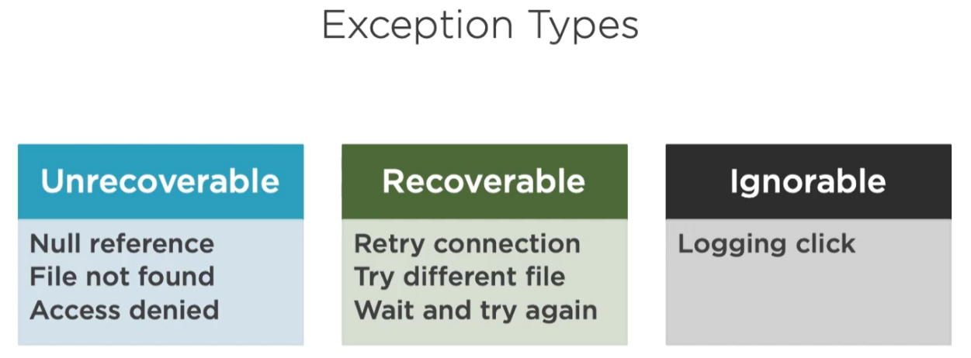
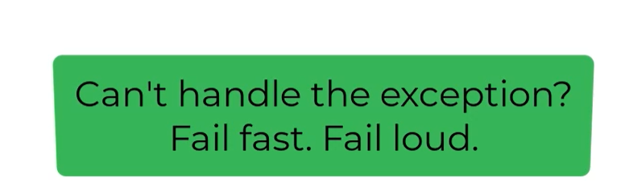
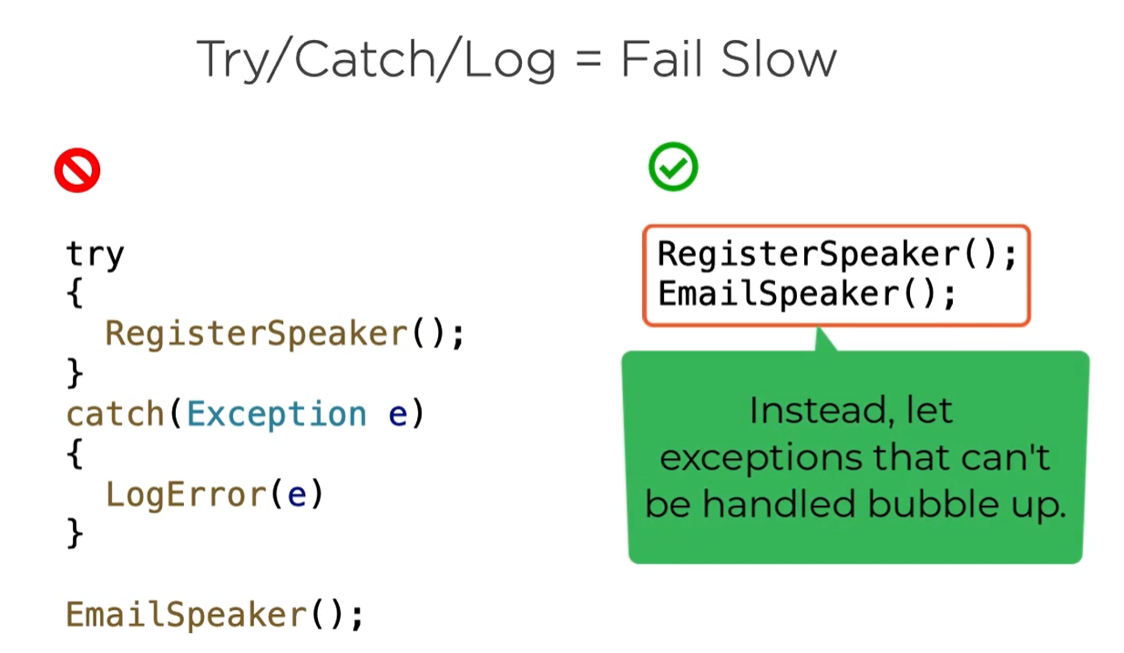
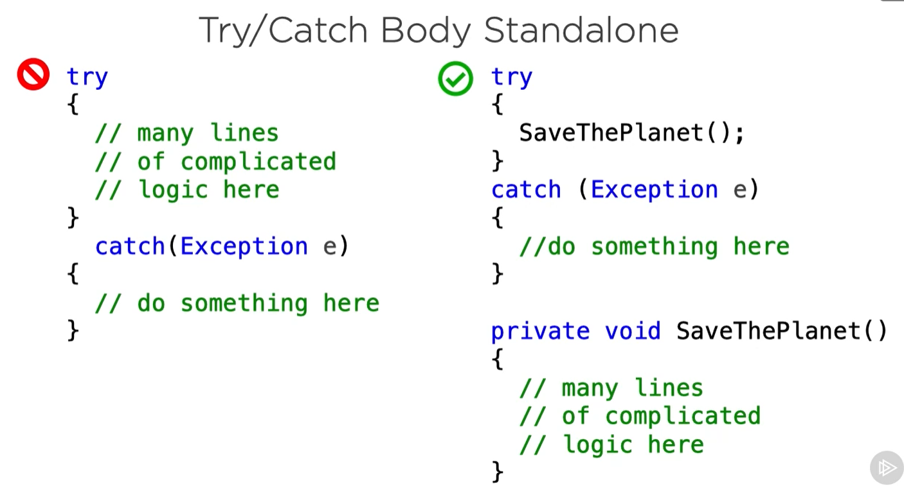
Exceptions

Slide 15
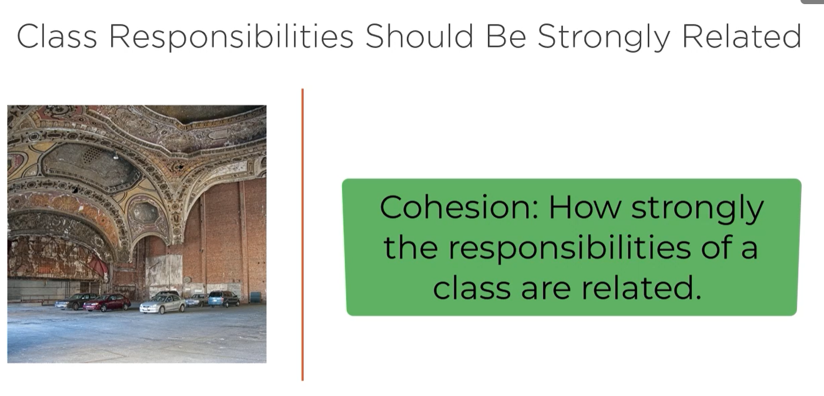
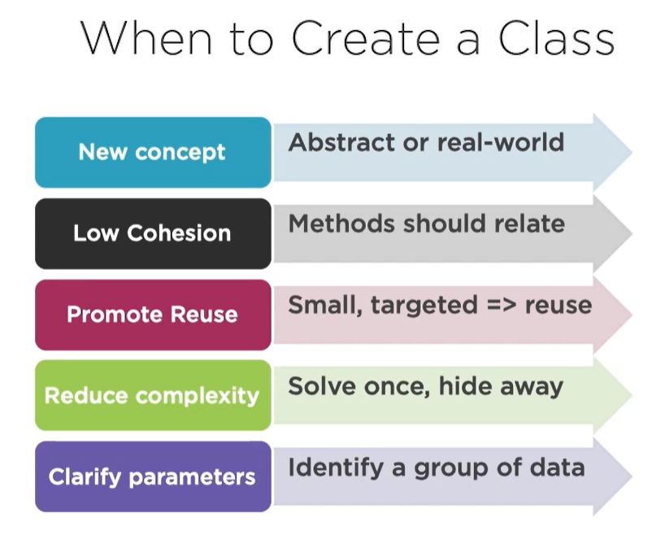
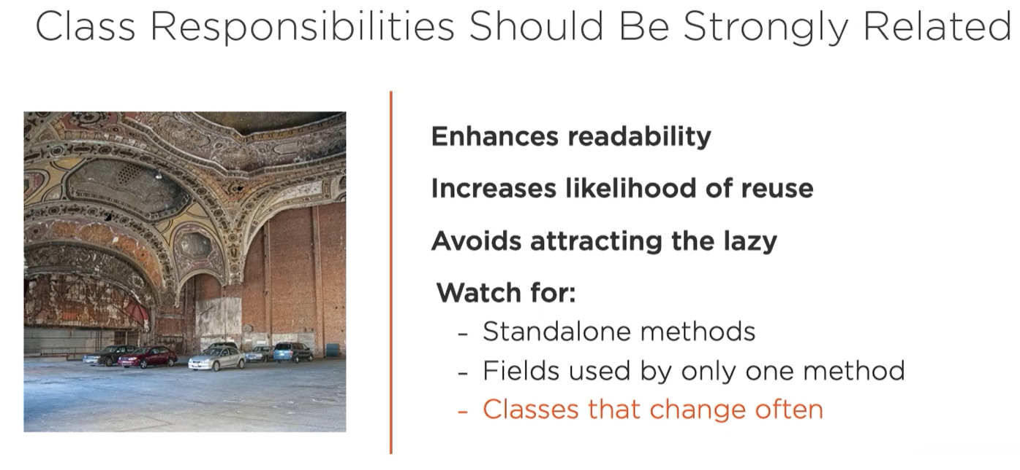
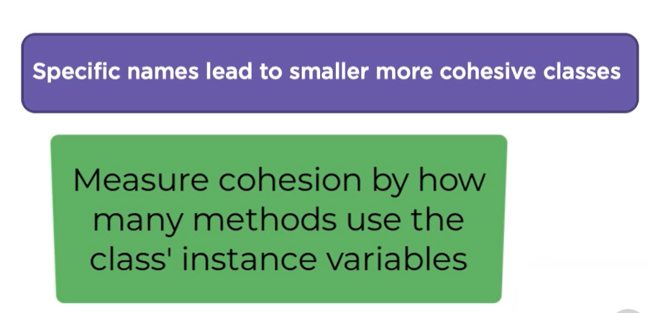
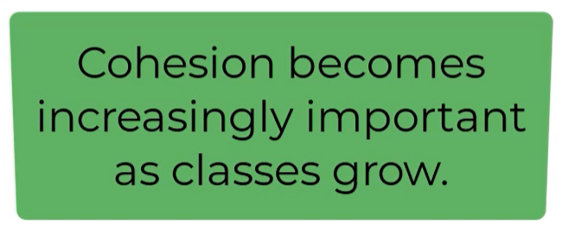
Classes

Slide 16
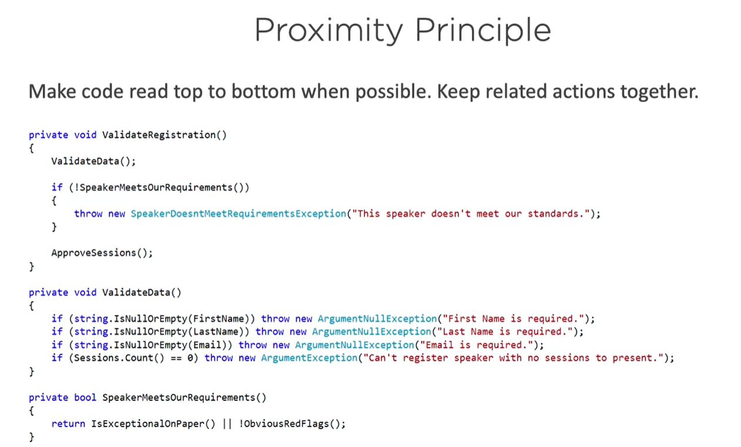
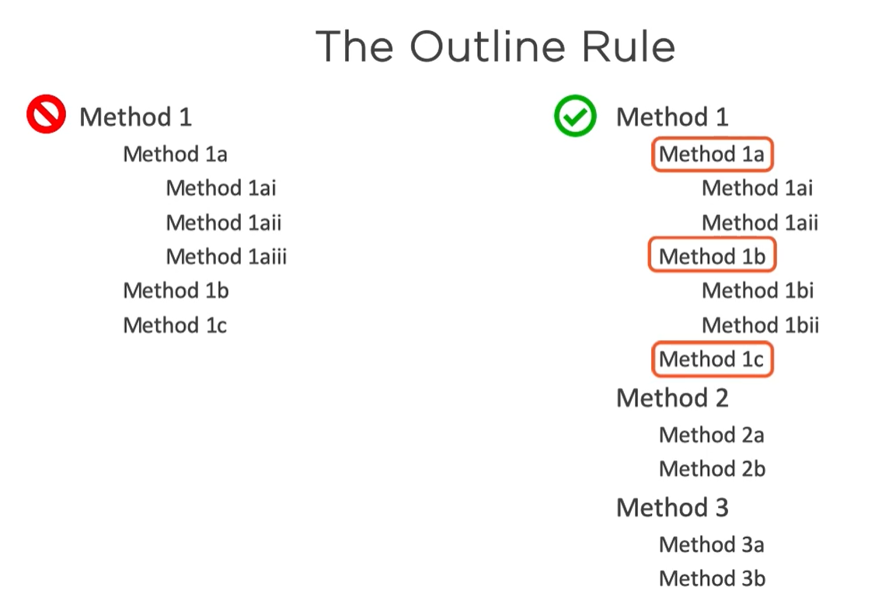
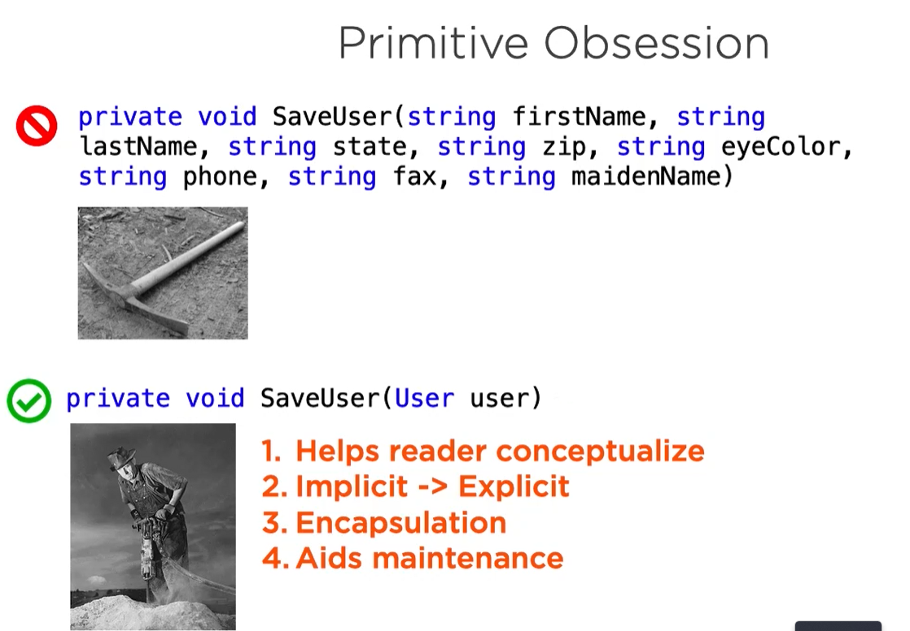

Slide 17
Comments
Self-documenting
1.3

Slide 18
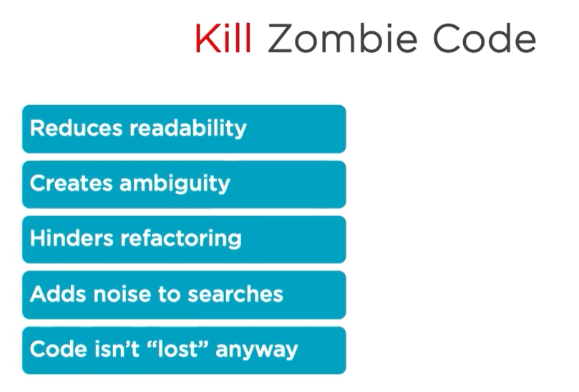
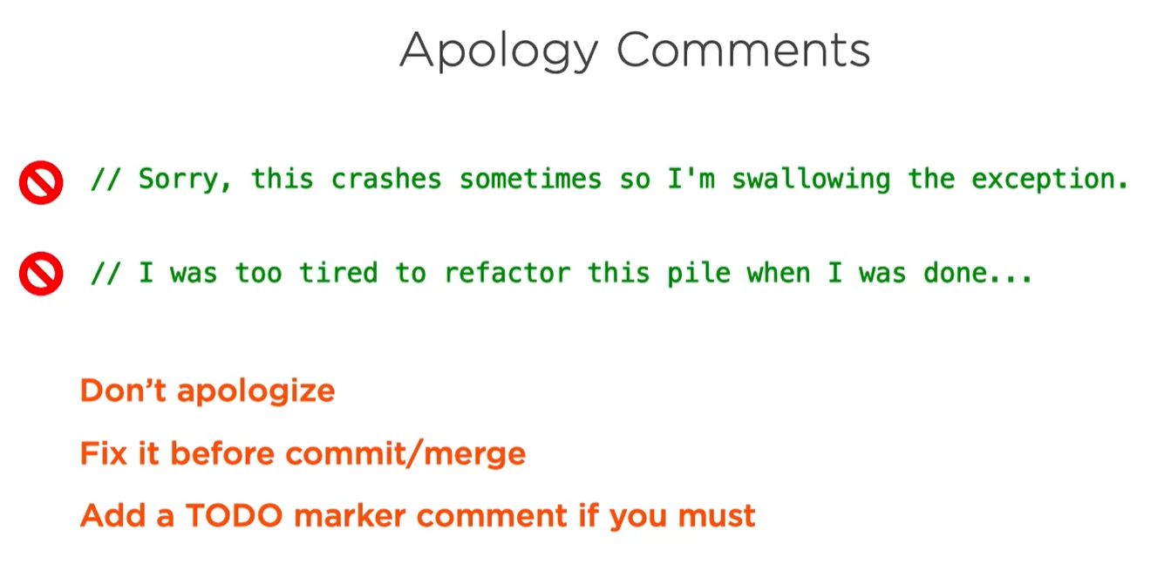
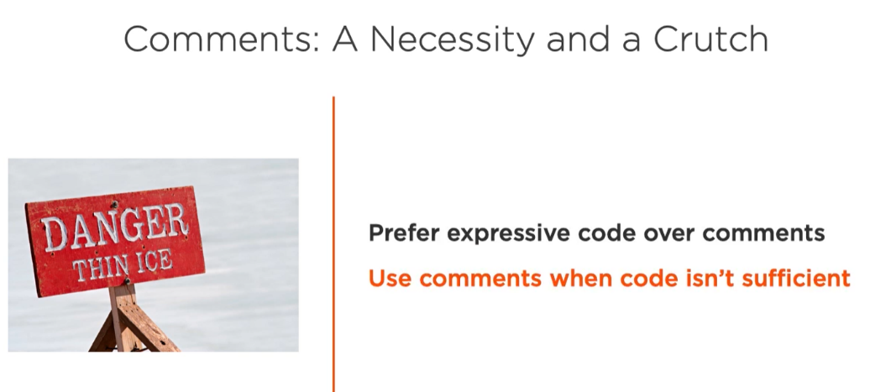


Comments
To Do Comments
Defect Logs
Summary Comments
Documentation

Slide 19
Not in this presentation
Git - ACID commit
2

Slide 20
No time in this presentation
Testing - ISTQB
3

Slide 21
Code metrics Static testing
Code Analysis
4

Slide 22





Slide 23



Slide 24
Why is Testing Necessary?​ / Why is Code Review Necessary? Root Cause Analysis Importance of Code Reviews
Code Review
5

Slide 25


Why is Testing Necessary?​ / Why is Code Review Necessary?

Slide 26


Why is Testing Necessary?​ / Why Code Review is Necessary?
Code review
Code analysis

Slide 27




Root Cause Analysis
Notes:
5 why
What are the causes of Errors in Software?​
Here we will discuss some possible causes of these errors.​
Time pressure: At times, software development happens under limited / insufficient resources with unrealistic deadlines. Developers do not have enough time to test their code before delivering it to the testing team. Which, in turn, introduces errors.​
Human fallibility: Human beings are prone to make mistakes. It would be foolish to expect the software to be perfect, and without any flaws in it! Ironically, we have not yet discovered any other non-human agent that can develop software better than humans. Therefore, we continue to rely on human intelligence to develop software. Thereby, increasing the possibility of errors in it.​
Inexperienced or insufficiently skilled project participants: Allocation of correct work to the correct resource is fundamental for the success of any project. Team members should be assigned a task according to their skills and abilities. An inexperienced project participant may make mistakes if they don't have proper knowledge of the work. For example, a resource having a good understanding of the database but having limited knowledge of HTML/CSS is not suitable for designing a website.​
Miscommunication between project participants: Improper coordination & poor communication between various departments in a project can result in disrupted progress. Conflicts can arise each time a project participant misinterprets or misunderstands the words or actions of another. For example, the business analyst does the requirement gathering, and then some other team member does the documentation of the requirements. Any miscommunication between the two can lead to incomplete/wrong requirement document, which, in turn, affects the design of the project.​
The complexity of the code, design, architecture, or the technology to be used: As the complexity of the program, concerning code, design or technology increases, the software becomes more critical and more bugs appear. It is because our brains can only deal with a reasonable amount of complexity or change. Our minds may not be able to process complex information like the form of design, architecture or technology, etc. Therefore, resulting in low quality and erroneous coding.​
Misunderstandings about intra-system and inter-system interfaces: There are high chances of error while establishing an intra-system, and inter-system interfaces. Let's try to understand what is intra-system and inter-system interfaces mean:-​
Intra-system interface- It implies the integration of different modules/features within a system/application. For example, in an online shopping portal, we have three modules: online order, shipping, and supply chain. These three modules form the intra-system for the online shopping portal. When these different modules are combined, there is a possibility of errors in the final product.​
The inter-system interface- It is the compatibility of an application with other applications when operated together. For example, compatibility between smartphones and tablets while data transfer via Bluetooth.​
New, unfamiliar technologies: Sometimes, the developers and testers need to develop an application using a technique that is unknown to them. Lack of proper knowledge and understanding can lead to errors. At that time, they require a certain level of R & D, brainstorming, and training to reach a reliable solution.​
Environmental conditions: Natural disasters, such as outbreaks of fires, floods, lightning, earthquakes, etc. can affect the computers. For example, a system may not work correctly if the software inside is affected by radiation, electromagnetic, or pollution.​
​
Enlisted below are some of the benefits, you will get:​
Prevent the reoccurrence of the same problem in the future.​
Eventually, reduce the number of defects reported over time.​
Reduces developmental costs and saves time.​
Improve the software development process and hence aiding quick delivery to market.​
Improves customer satisfaction.​
Boost productivity.​
Find hidden problems in the system.​
Aids in continuous improvement.​
​
Troubleshooting vs. root cause analysis​
RCA and troubleshooting are different processes. Troubleshooting and general problem-solving methodologies solve specific problems. For example, if an application's health monitoring reveals that a software instance crashed and is unresponsive, the team may resolve the problem by restarting the software instance or rebooting the server.​
Root cause analysis for software defects, however, might reveal that the software becomes unresponsive because of a certain error condition. Perhaps the application can't access data, and the software isn't designed to handle such errors gracefully. In response, the team can release a software patch that addresses the error handling and will likely prevent the problem from recurring.​
​
​

Slide 28


Importance of Code Reviews

Slide 29






Slide 30





Slide 31





Notes:
Second image refer to atomic commit

Slide 32




Slide 33





Notes:
Praise I have to done more

Slide 34




Notes:
Don’t means it is always possible to stop to 2 iteractions byt you can try to do your best with example in the comments

Slide 35



